Slide 1


Introduction to AI-Driven Personalized Online Learning Pathways
Discover how AI can revolutionize your online learning experience, unlocking personalized roadmaps for success in diverse technical fields.

Slide 2
Personalized Learning for Technical Fields
Tailored Paths
Adaptive Curriculums
Personalized learning roadmaps guide individuals through the key concepts and skills needed to master specific technical disciplines.
Based on skill assessments, the platform adjusts the learning content and pace to match each user's unique needs and goals.
Skill Development
Flexible Exploration
Roadmaps outline a progressive sequence of courses, projects, and resources to methodically build core competencies in areas like web dev, data science, and more.
Users can explore different technical tracks, customize their learning journey, and discover interdisciplinary connections between fields.

Slide 3

Web Development Learning Pathway
Embark on a comprehensive web development learning journey tailored to your needs. Explore a curated curriculum that covers essential skills, from HTML and CSS to advanced JavaScript and modern frameworks.
Our adaptive learning algorithms will guide you through personalized milestones, ensuring you master the fundamentals and stay motivated on your path to becoming a skilled web developer.

Slide 4

Data Structures and Algorithms Learning Pathway
Mastering Fundamental Data Structures: Arrays, Linked Lists, Stacks, and Queues
Exploring Advanced Data Structures: Trees, Graphs, Heaps, and Hash Tables
Diving into Algorithmic Techniques: Recursion, Divide-and-Conquer, Greedy Algorithms, and Dynamic Programming

Slide 5

AI Learning Pathway
1
Foundations of AI
Understand core concepts like supervised, unsupervised, and reinforcement learning. Master mathematical foundations in linear algebra, calculus, and probability.
2
Algorithms and Techniques
Dive into popular ML algorithms like regression, classification, clustering, and deep learning. Learn to implement these in code using libraries like TensorFlow and PyTorch.
3
Real-World Applications
Apply your ML knowledge to projects in areas like computer vision, natural language processing, and predictive analytics. Build end-to-end ML pipelines to solve complex business problems.

Slide 6

Data Science Learning Pathway
Embark on an immersive data science learning journey, mastering essential skills from data exploration and preprocessing to advanced machine learning techniques. Dive into the world of predictive analytics, data visualization, and real-world problem-solving.
Follow a curated curriculum that adapts to your needs, guiding you through foundational concepts, popular tools and libraries, and hands-on projects to build a robust data science portfolio.

Slide 7
Roadmap and Course Recommendations
Beginner
Intermediate
Start your journey with foundational courses in programming, data structures, and web development.
Expand your skills in machine learning, data science, and advanced algorithms to tackle complex problems.
Advanced
Personalized
Dive deep into specialized topics, such as deep learning, cloud computing, and full-stack web development.
Receive tailored course recommendations based on your goals, interests, and learning preferences.

Slide 8



Chatbot for Q&A
Ask Anything
Recommended Resources
Personalized Support
Get instant answers to your questions about web development, data science, and more.
Receive personalized suggestions for the best courses, books, and learning materials.
Engage with the chatbot for tailored guidance and troubleshooting throughout your learning experience.

Slide 9
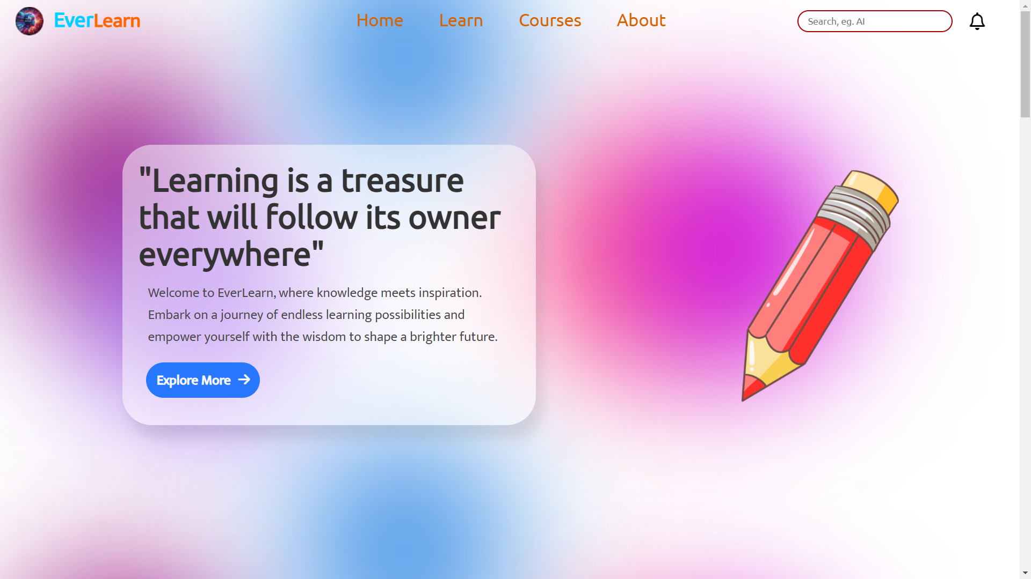

Slide 10
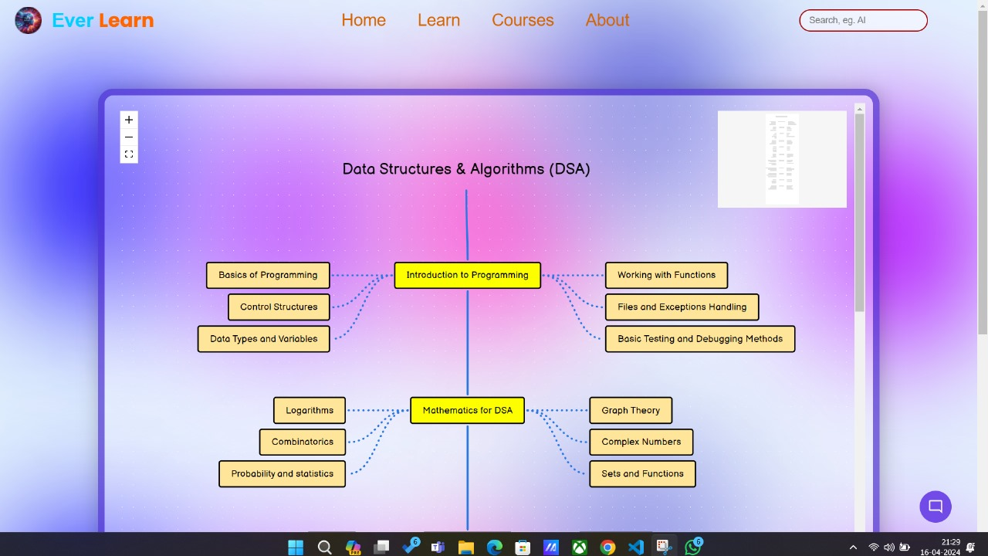

Slide 11
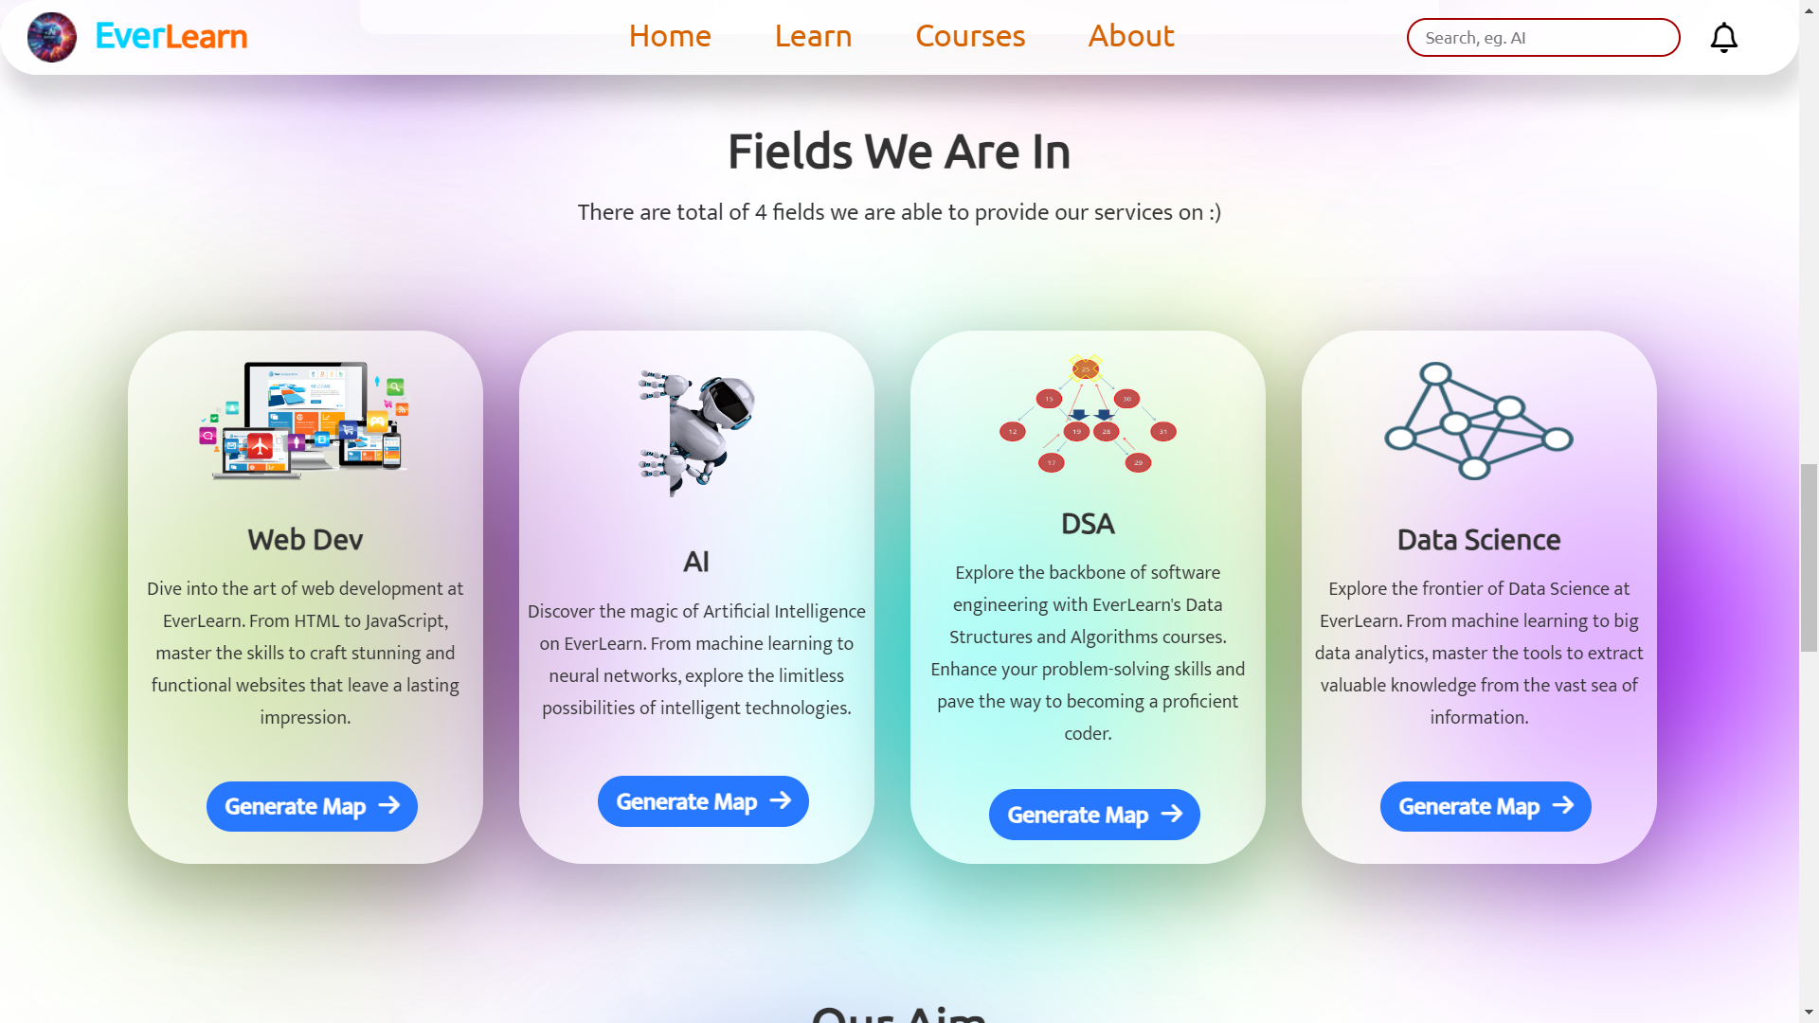

Slide 12
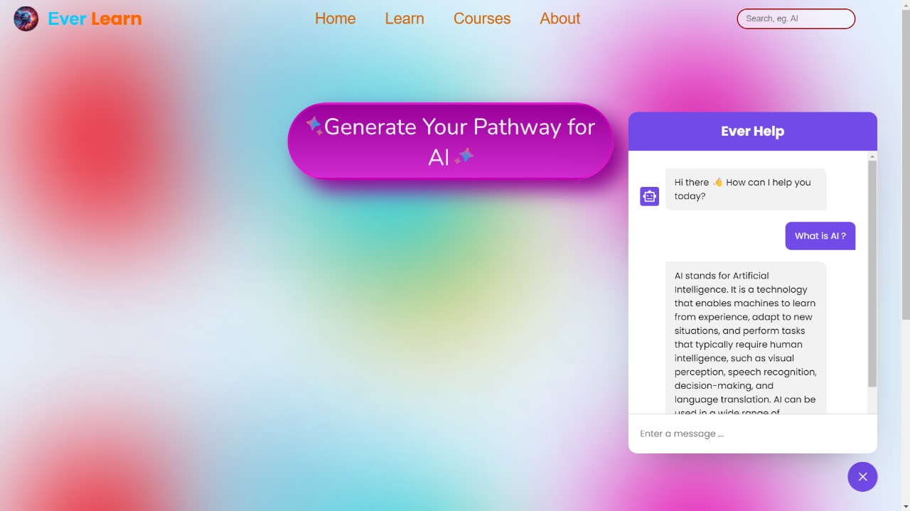

Slide 13

Technology Stack used in Development
Front-End
Back-End
HTML
CSS
JavaScript
Node.js
Express.js
Data Base
API
Mongo DB
API of Chat GPT

Slide 14

Conclusion and Future Scope
As we've explored, AI-driven personalized online learning pathways offer a powerful solution to help individuals navigate and master technical fields like web development, data science, and machine learning. Moving forward, we're excited to continue enhancing the platform's adaptive algorithms and community features to provide an even more tailored and engaging learning experience.

Slide 15
Thank You

